Slide 1
The rules of Water Skyball

Slide 2
Goal
The goal of this session is to enable you to play the game and to make you understand all the matches tomorrow.
Notes:
we won’t go into practice today
we won’t speak about the referee signs and their role, as there is a separate session later

Slide 3
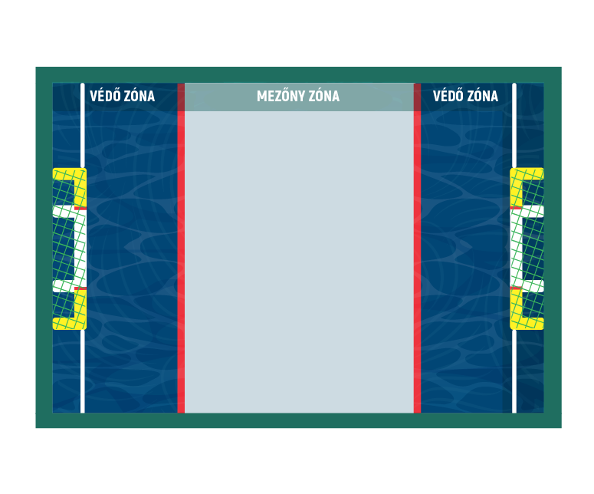
Requirements
10.5 - 11m
Field
Ball
Goals
2x2 players
min. 10 mins
Water depth: 100-120cm
Water temp: min. 20ºC
3m
4.5 - 5m
3m
8m
Notes:
As you already know, a team is made up of 2 players, and a game lasts 10 minutes.
I will not speak about the ball here, as it was discussed in the previous session.
What’s important is the depth of the water. This is shallow water. You can swim in it if you want, but you don’t have to, at the same time you can jump freely and enjoy the water.
<field on the next slide>

Slide 4
Zones
Defender zones
only 1 player at a time, including the opponent
Midfield zones
any number of players
The value of a goal depends on the zone of the throw
3m
4.5 - 5m
3m
Notes:
Understanding the fields is very important, as there are strict rules around who can stay in or reach into a field given the position of other players
Defender zone: 1 player at a time
Midfield: any number of player
One might gain possession of the ball just by positioning themselves around the zones
The drawing does not show the middle line of the field, that’s important as well at the start or restart of the game, like after every goal. When the game is restarted, the 4 players are “separated” from each other. 1-1-1-1
The value of the goal depends on the zone of the throw. You can score from the midfield and your defender zone.
<next slide>

Slide 5
The goal
Scoring on the sides scores 1 points
Scoring in the middle scores 2 points
Scoring from your own defender zone doubles the points above
A goal is scored if more than 50% of the ball passes the centerline of the goal line.
After a starting whistle, the ball must be possessed by at least two players before crossing the goal line to count as a valid goal
Notes:
The goals have a special goal in a goal structure. There is the external and the internal part.
The internal part doubles the value of the external part.
Scoring from distance doubles the value again.
Penalties should be targeted at the internal part.

Slide 6
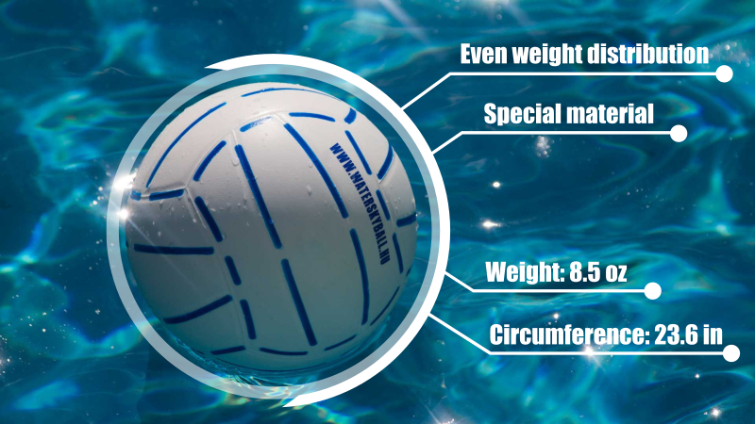
The ball
spherical,
made of rubber,
its circumference is between 62 cm
weighs 240 grams,
colors and pattern: colors and pattern defined and approved by the Hungarian Water Skyball Association

Slide 7
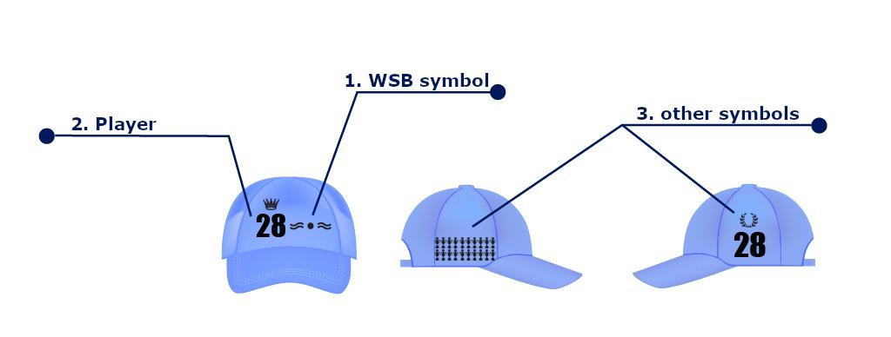
Players
2 players per team
no substitutes
players must wear a cap
no jewelry during the game

Slide 8
No contact
Every physical contact (even the intent) is forbidden between the players
Player’s Area: Each player has an area of an arm's length radius. The other player must not reach or make a move into this area. The direction of movement of the area is determined by the head’s line.
Examples of contact:
Walking, running, jumping into another player’s area
Standing still, and leaning into contact, instead of avoiding it
Crossing another player’s area when throwing the ball
Tackling a free ball immediately after another player
Being dangerous to ourselves
Notes:
Every physical contact (even the intent) is forbidden between the players
Player’s Area: Each player has an area of an arm's length radius. The other player must not reach or make a move into this area. The direction of movement of the area is determined by the head’s line.
Stopping a moving player by the arm is forbidden
Examples of contact:
Walking, running, jumping into another player’s area
Standing still, and leaning into contact, instead of avoiding it
Crossing another player’s area when throwing the ball
Tackling a free ball immediately after another player
Being dangerous to ourselves

Slide 9
Players on the field
At the start of a game
1-2-1
During the game
no contact rule
defending a territory by body, not by arms
defending by two arms is forbidden
occupied defender zone: “the wall”
always finish a zone change
playing in the opponent’s defender zone
Intercepting the ball by positioning (next slide)
Notes:
At the start of a game
1-2-1
During the game
no contact rule
defending a territory by body, not by arms
defending by two arms is forbidden
occupied defender zone: “the wall”
always finish a zone change
playing in the opponent’s defender zone
Intercepting the ball by positioning (next slide)

Slide 10
Intercepting by positioning
Interception always requires an action from the intercepting team!
has the ball
Notes:
kattintások:
front interception
rear interception

Slide 11
Ball handling
It’s forbidden to
grab the ball (except for the goalkeeper when defending)
touch the ball with both hands in the midfield (including a block or catch)
throw using both hands
hit the ball (either with a fist or palm, except for the goalkeeper)
It’s a valid move to
throw with a single hand
throw holding the ball on the palm
Notes:
It’s forbidden to
grab the ball (except for the goalkeeper when defending)
touch the ball with both hands in the midfield (including a block or catch)
throw using both hands
hit the ball (either with a fist or palm, except for the goalkeeper)
It’s a valid move to
throw with a single hand
throw holding the ball on the palm

Slide 12
Starting a game
Players’ positions (1-2-1 line up)
goalkeepers are in their defender zones
midfielders are on their half
no player is allowed to cross the center of the field before the game starts
no goal can be scored from throw-out
The 4 ways to start a game (throw out)
the goalkeeper throws the ball to himself,
the ball hits the water surface,
the ball leaves the defender zone,
the goalkeeper exits the defender zone with a ball in his hand.
Notes:
Line-up at the (re-)start of a game
The 4 ways to start a game (throw out)
the goalkeeper throws the ball to himself,
the ball hits the water surface,
the ball leaves the defender zone,
the goalkeeper exits the defender zone with a ball in his hand.

Slide 13
Scoring a goal
A goal can only be scored with a hand-launched shot
1
2
2
4
Notes:
A goal is scored if more than 50% of the ball passes the centerline of the goal line.
After a starting whistle, the ball must be possessed by at least two players before crossing the goal line to count as a valid goal

Slide 14
Penalty
Taking away the ball
1 penalty
2 penalties
3 penalties
Penalty must be taken at first intention
The team that threw the penalty continues with a throw-out
Notes:
10.2. Taking away the ball
The referee may penalize the offensive team with taking away the ball if:
at the start, at throw-out, the midfield player of the starting team is ahead of the midfield line;
they play passively (they do not change and do not strive to score);
the offensive team keeps the ball for more than 8 seconds in the defensive zone;
the player in the midfield zone reaches in or steps into the opponent's defender zone while there is an other player in that zone (including arm swing after a shot);
a direct shot after throw-out, which leaves the playing field (including through the goal line) without being touched by any other player;
a player throws the ball out through his/her own baseline deliberately;
if an offensive player is in the other team’s defensive zone and does not strive for action and/or does not leave the defensive zone at first intent.
10.3.1. One penalty throw
One penalty may be given in the following cases:
gripping on the ball;
for a two-handed block - in this case, if the ball was heading to the goal, the goal must also be counted and recorded at the higher score value, i.e. 4 points (Deadeye) if thrown from the defensive zone, or 2 points (Center) if thrown from the midfield;
holding or touching the ball in the midfield with both hands;
punching or hitting the ball with a fist in the midfield;
intentional splashing;
intentionally pushing the ball under water;
deflecting the ball with water;
for basketball-style throw: the two hands are not clearly separated when preparing to throw;
if the offensive player enters the opponent's defensive zone while someone already there;
for zone acquisition foul: the player enters in and out a zone with one foot and does not close the other foot next to it;
if a player in the defensive zone reaches out with his/her hand for a ball in the midfield zone without exiting;
if the offensive player, who is in the opponent's defensive zone with a ball, passes and does not leave the defensive zone at first intention.
10.3.2. Two penalty throws
Two penalties may be given in the following cases:
for inside defense: two players are in their own defensive zone, or the player just hangs into, reaches in the defensive zone when someone is already inside;
for physical contact (touch), for the non-offending team;
for joint physical contact (joint touch), for the benefit of both teams,
for defensive foul: the player reaches or enters the area of the offensive player,
for offensive foul: the player reaches or enters the area of the defensive player.
10.3.3. Three penalty throws
Three penalties may be given for serious fouls in the following cases:
dangerous play: serious negligence committed in the midfield, and dangerous movement,
joint dangerous game, for the benefit of both teams;
rude, unsportsmanlike behaviour.

Slide 15
The ball leaves the field
When the ball leaves the field, the game continues with a throw out
if the ball leaves the field of play on the sides, the opposing team is the next with a throw-out,
if the ball leaves the field from one of the attacking team's players at the opponent's baseline (including the situation of a goal), the defending team may bring the ball back into play by a throw-out,
if the ball leaves the field from the defensive team's goalkeeper through the baseline, it is the defending team’s turn to restart with a throw-out,
if the ball leaves the field from the defensive team's midfield player through the baseline, except for the goal line, it is the defending team’s turn to restart with a throw-out.

Slide 16
Summary
A goal is worth either 1, 2, or 4 points
Always avoid physical contact
Never squeeze the ball in the mid field
Use single hand only when handling the ball in the mid field
Learn how to intercept by positioning yourself
More rule discussion with examples comes in the next session
Part 1: Getting started with WSB

