Slide 1
Water skyball referee activities

Slide 2
Goal
The goal of this session is to introduce you to the water skyball referee activities and to highlight the differences compared to other sport referee activities.

Slide 3
Role of the referee in water skyball
To enforce the rules and the WSB ethos during the games - from the point they are about to enter the playing field till they leave it.
Checks if the players are prepared physically (e.g. health, jersey, no jewelry),
Checks if the players are prepared mentally (e.g. aware of the rules),
With his/her decisions and instructions, keeps the game within the borders of the rules and ethos.
What skills does a WSB judge need?
Situational awareness,
Fast decision-making,
Self-sufficiency,
Accurate knowledge of rules and ethos of WSB.

Slide 4
Referee team structure and duties - WSB official matches
Referee team:
1 referee,
2 line judges,
1 scorer,
1 assistant scorer.
The referee team and their duties during the WSB Grassroot sport events differ from the referee team during the championship matches due to the different conditions.

Slide 5
Referee and supplementary team duties - Grassroot sport events
Referee:
Leads the matches,
Stops the matches in order to clarify and explain the rules if necessary,
Allocates the caps to the new players, and at the end of the matches takes them away from the players.
Supplementary team:
Coordinator
Explains the rules of the game to those who are interested,
Registers the new players and teams,
Manages the schedule of the matches,
Calls the registered teams to play and sends them into the water.
Scorer
Timekeeper (10 minutes),
Indicates the remaining time to the referee and players,
Indicates the score on a scoreboard.
Ball boy/girl (optional)

Slide 6
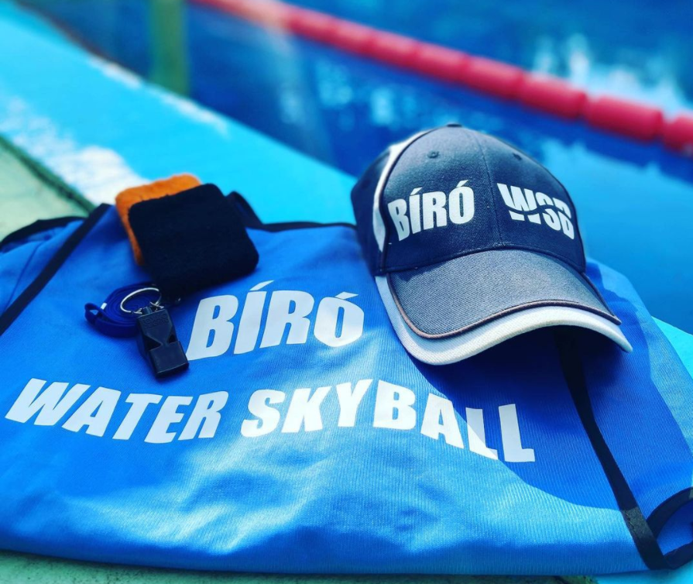
Referee signals and equipments
Signals of the referee:
whistle to start/stop the game and to indicate goals or fouls,
shows the score of the goals with his/her hand,
shows the direction of the attack to the teams after goals or fouls.
Equipments:
Jersey (cap, vest),
Whistle,
License.

Slide 7
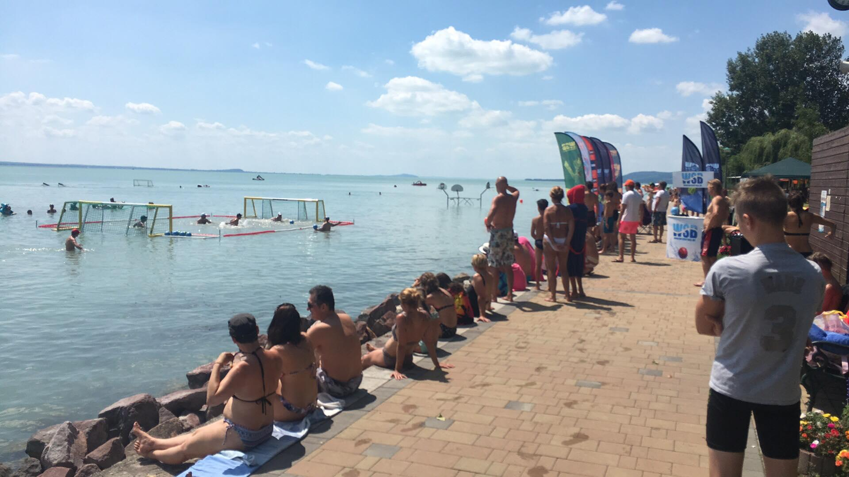
Schedule of the grassroot sport events’ matches
Matches are 10 minutes long
Time for preparation before the matches start
Way of timekeeping: running clock
What happens in case of a tie?

Slide 8
Important details
Referees are players as well - thus, they see the game from a different perspective
There are cases when the decision depends on the referee
Relationship between the WSB rules and the ethos: if there is a case that the rules don’t cover, the referee should decide in accordance with the ethos

Slide 9
Quiz
As a referee, how many points would you give for the scores?
https://www.youtube.com/watch?v=sb2zhCmWOoM

Slide 10
Q&A

