Slide 1
Water skyball grassroot sport event organisation
How to organise successful grassroot sport event for a new sport?
Notes:
Nyitó dia, hogy milyen tudásra tesznek szert a prezi végére

Slide 2
Goal
The goal of this session is to introduce you to the WSB grassroot sport event organisation characteristics and to make you understand what is happening on a sport event.

Slide 3
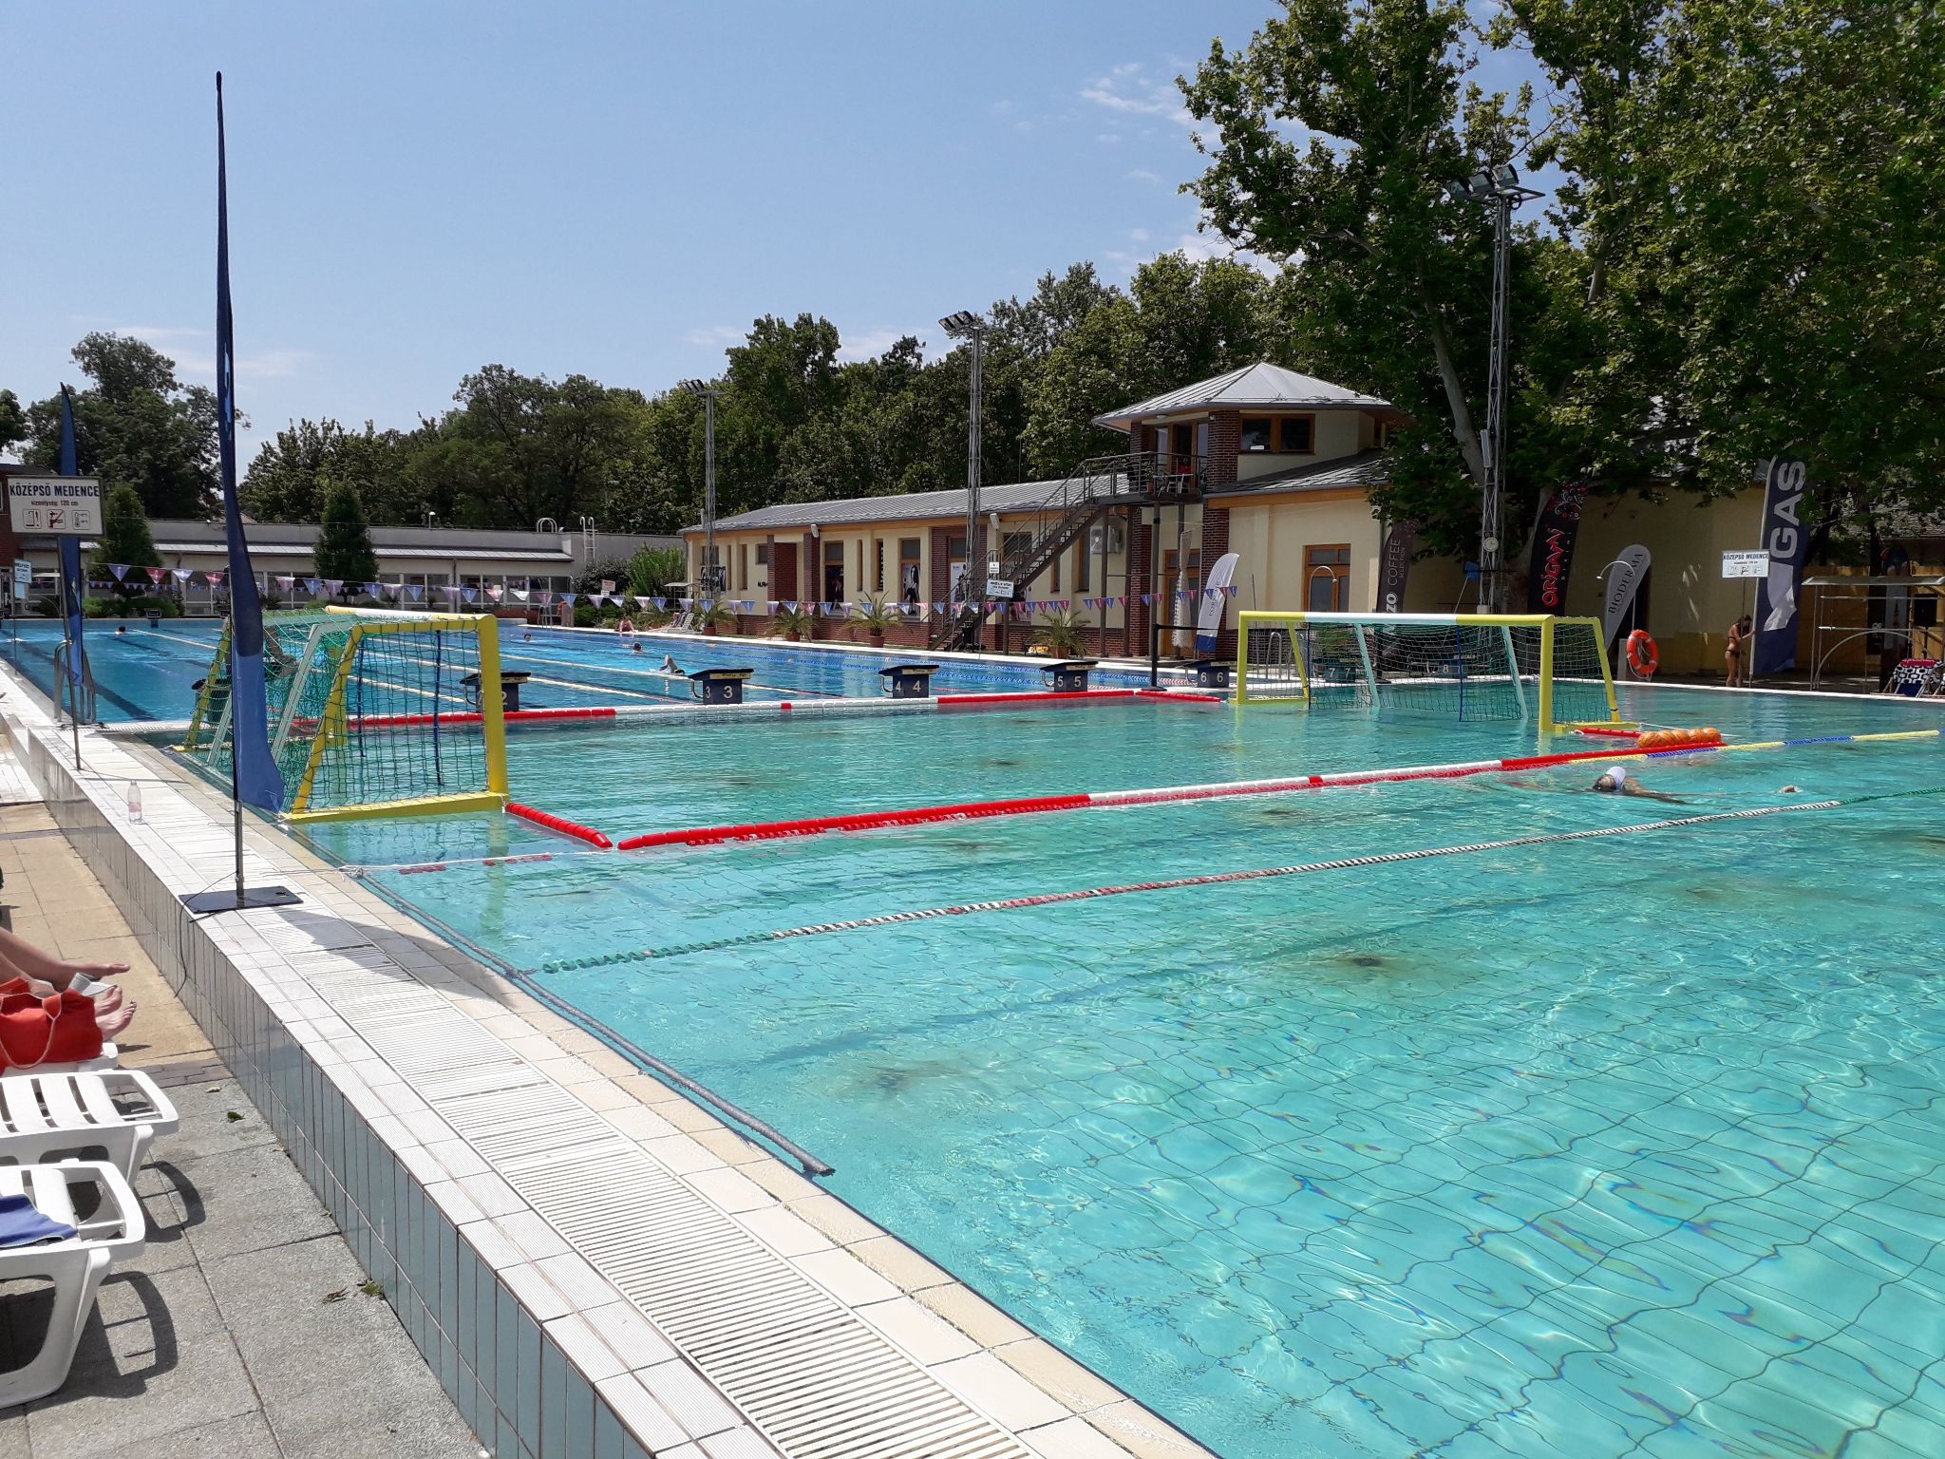
Preparation
Selection of the appropriate sport event venue
Contacting the sport manager (technical manager) of the venue
Checking the possibility of first aid, field installation, required logistics
Event advertisements
WSB mobile field
Suitable means of transport: mini van or trailer
Arranged, boxed delivery of the equipment
Equipment checklist

Slide 4
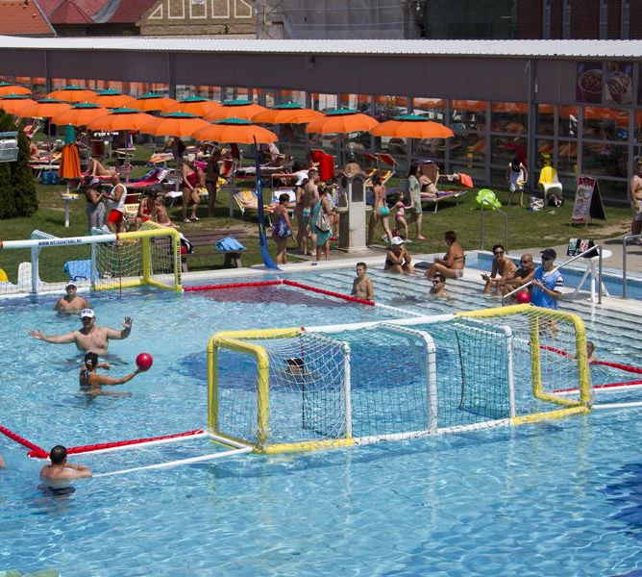
Venue of the sport event
Adequate physical conditions for the WSB field:
Depth of water: 100-120 cm
Ground of the field: sand (natural waters) or concrete, tiles, special plastic (swimming pool)
Anchorage points of the field
No waves, clear sunny weather
Notes:
Anchorage points: a) to the pool wall with ropes or buoy lines, b) to the pool wall with screws c) to concrete blocks at the bottom of the pool

Slide 5
Venue of the sport event - Logistics
Equipment have to be delivered and unloaded on site
Suitable parking place and unloading place is needed
Storage of the equipment on site
Installation of the WSB field (at least 2 persons)
Setting up the following equipment (at least 4 persons):
a registration desk
a tent for the staff members and the loudspeaker
sound technology
beach flags
Electric power source for electric devices
Enough space for spectators

Slide 6
Key roles in the organising team
Manager:
keeps in touch with the sport manager of the venue,
keeps the time frame,
coordinates the WSB field installation and disassembling work,
takes pictures and videos of the event for dissemination purposes,
replaces others if necessary.
Announcer:
handles sound technology,
broadcasts demonstration matches,
explains the rules,
promotes the event,
calls registered teams to play.
Referee team members: referees, coordinator, scorer, ball boy/girl

Slide 7
Volunteers
Volunteers are WSB athletes, association members, fans
Sports events are largely based on their participation
Activities:
instructing WSB rules
inviting new participants
participating in the referee team: coordinator, scorer, ball boy/girl
doing referee activities if they have licence
demonstrating how to play WSB
creating a good atmosphere :-)

Slide 8
Target audience
Reaching the right target audience by the following:
age (12-60 years)
gender: men and women
number of participants: 100 persons
How to reach the target audience?
newsletters
online advertisements (Facebook, Twitter, website news)
online invitation letters
on site loudspeaker
on site volunteers
match broadcasting on the spot
on site equipment (beach flags, T-shirts, registration desk, etc.)
demonstration matches

Slide 9
How do participants come?
Online advertisements
Announcing on the beach
Watching WSB matches
Registration desk
Invitation by volunteers
On site advertisements

Slide 10
Process of learning the WSB rules
Watching WSB matches
Announcer’s instructions in the announcer
Before registration
Reading the WSB rulebook extract
At registration
Coordinator’s instructions
Before and during the match
Referee’s instructions

Slide 11
Time management
Matches are 10 minutes long
No extra time
5 matches per hour, 5x10 min. + 2 minutes per match for preparation
40 matches per 8 hours (a one-day long sport event)
Changing the referees every 1 hour
2 referees are able to do a one-day long sport event
1 hour for the WSB field installation
1 hour for the WSB field disassembling

Slide 12
Questions and answers

