Slide 1
Introduction to Water Skyball sport
Part I

Slide 2
Goal
The goal of this session is to introduce you to the water skyball sport and to present its uniques characteristics.

Slide 3
What is water skyball?
Water Skyball is a Hungarian invention, an exciting and amusing water sport played by 2 against 2 along special rules.
The game is played in water by 2 teams of 2 players, with one ball. The object of the game is to throw goals with the ball. These are the only similarities to any other water sports, in every other aspect it is unique. Its field, equipment, rules, ethos are special and they offer a playful, exciting activity full of challenges both for the players and for the audience and fans.

Slide 4
Hungarian sport filling a gap
The reason for the development of WSB was the need for a new water sport that is
easy to learn
fun to play
playable in smaller teams (2 vs. 2)
available for a wide range of people from the age of 12 to 60
emphasising agility and tactics over physical strength (no-contact rule)
available for mixed teams consisted of a female and a male player, or a kid player and an adult player
scientifically backgrounded
feasible in swimming pools and natural waters as well
Similar sports: water polo, water volleyball, water basketball, underwater hockey

Slide 5
History
Result of Fontanus Scientific Methodological Research and Educational Center (carried out by doctors, coaches and specialists)
2013-2014 - Development years, smaller tournaments
2015 - 1st national championship
2015-ongoing - Organisation of national championships every year
2019 - Foundation of Hungarian Water Skyball Association (umbrella organisation of 10 sport clubs)
2020 - Broadcasting the national championship on an online platform (mindigTV GO)
2021 - Broadcasting the national championship in Hungarian sports TV (Spieler 1, Spieler 2)

Slide 6
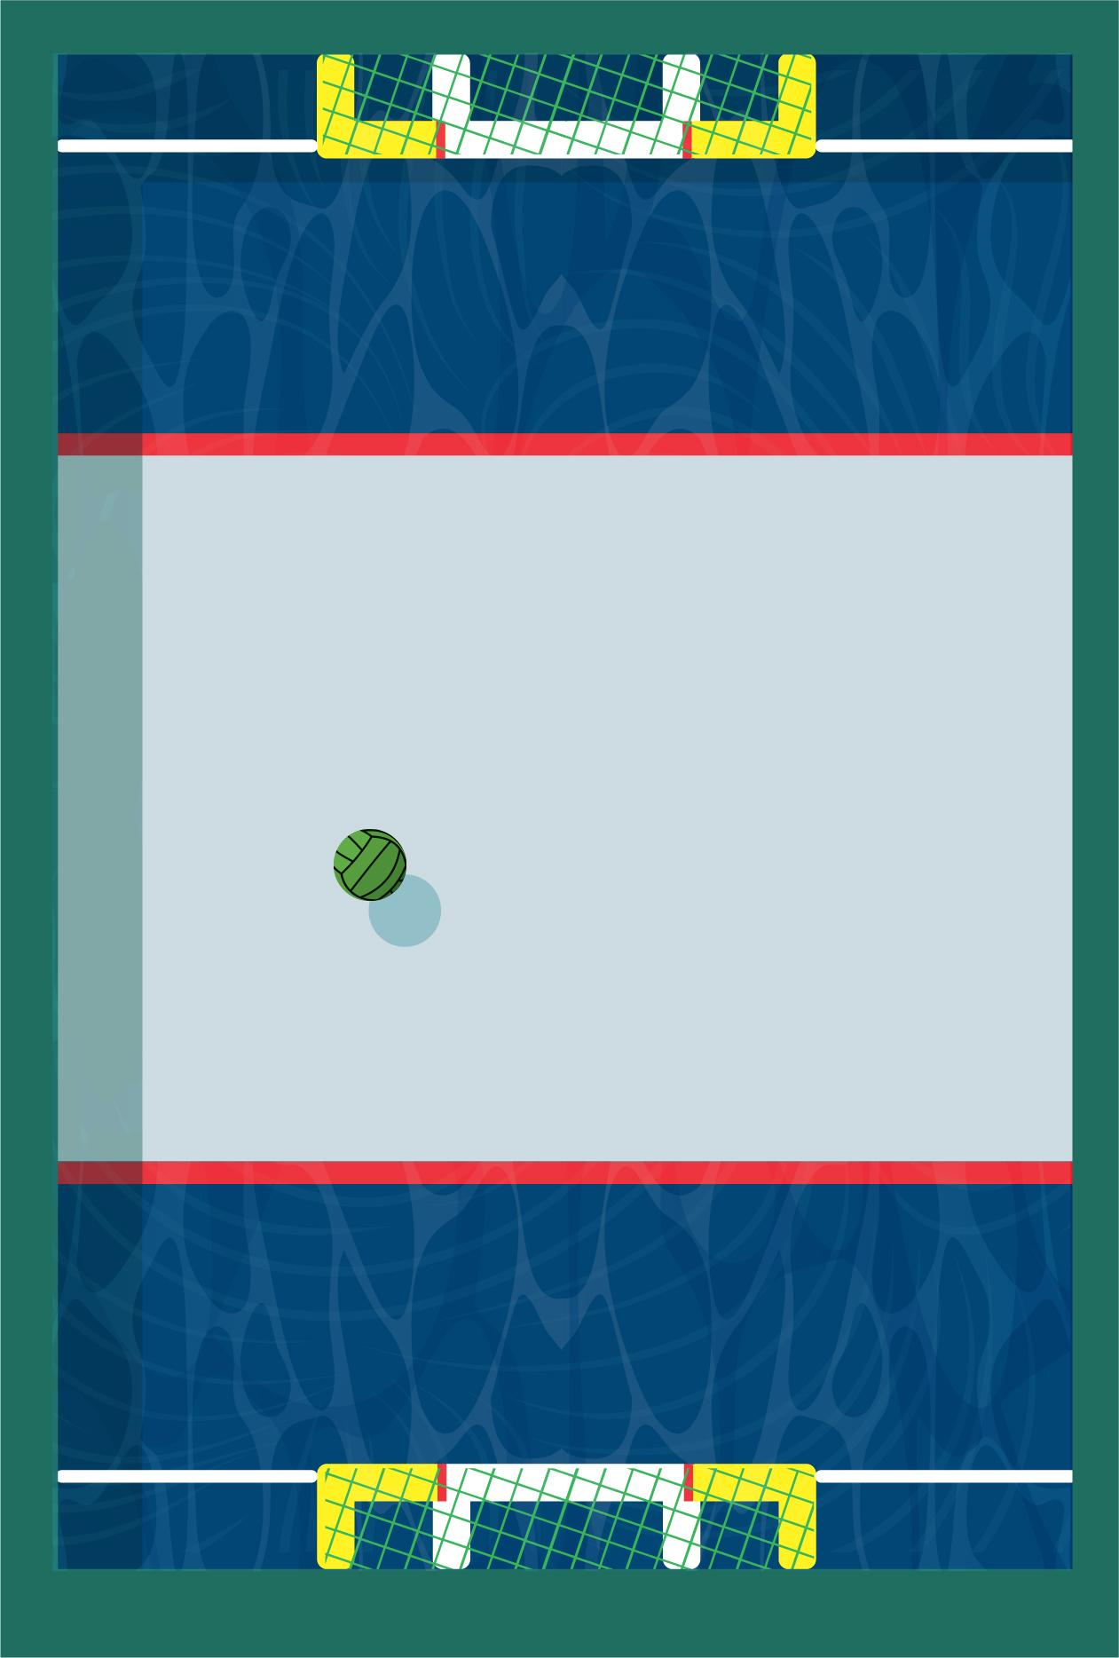
Attributes of a WSB field
10 x 8 meters field
100-120 centimeters water depth
3 zones (defender - midfield - defender)
It can be a permanent installation or a mobile field
Easy installation in a wide variety of settings (swimming pools, beaches, natural waters, spas)
Currently in Hungary there are approx. 600 baths in operation, among them 200 are swimming pools.

Slide 7
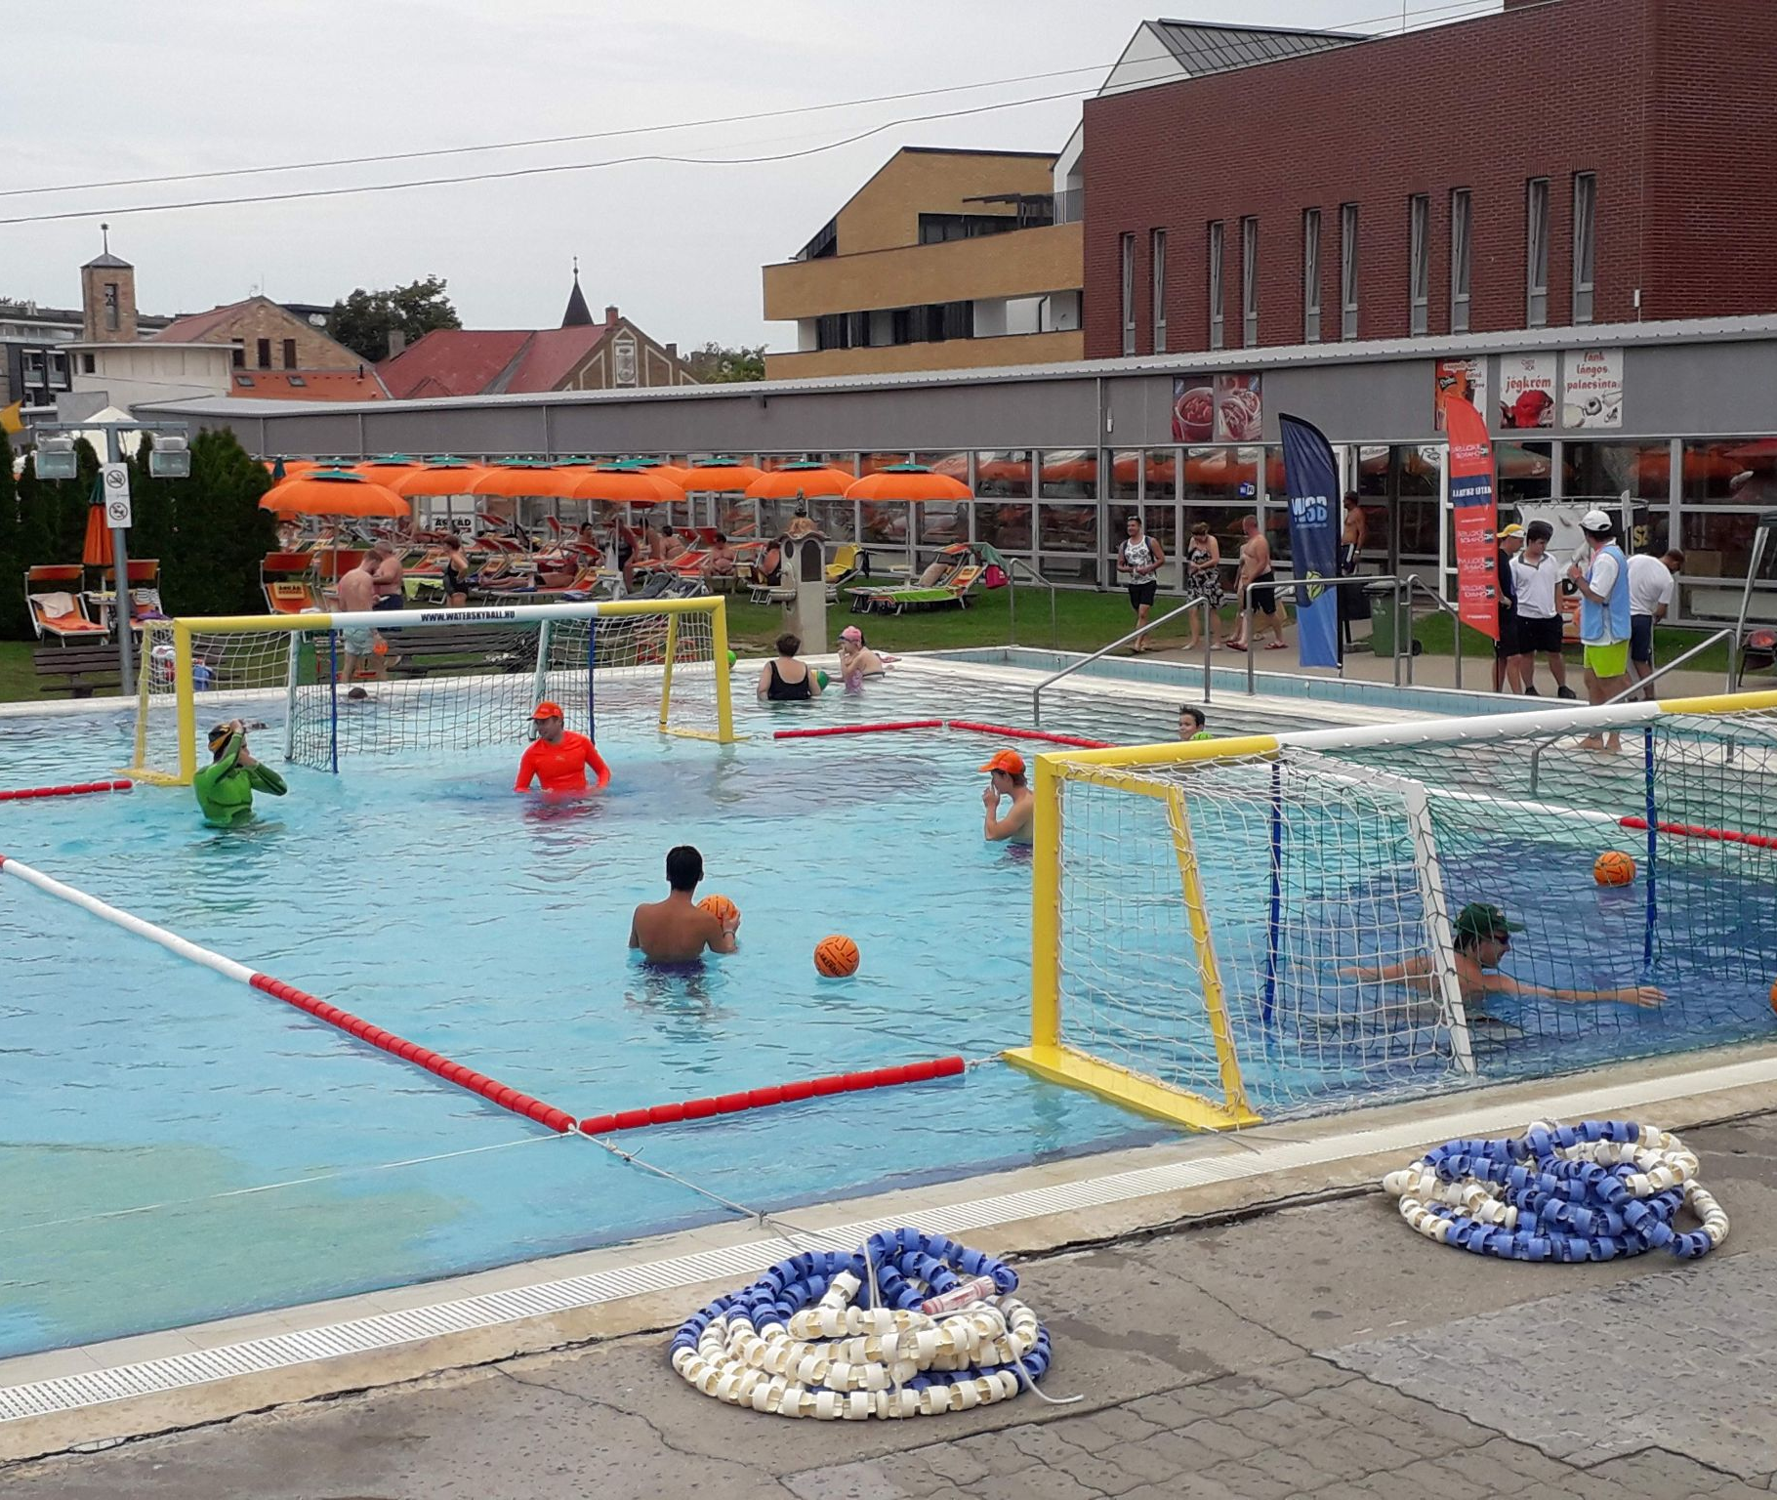
2 versions of WSB mobile field
Metal WSB mobile field
made of 2 aluminium goals and buoy lines

Slide 8
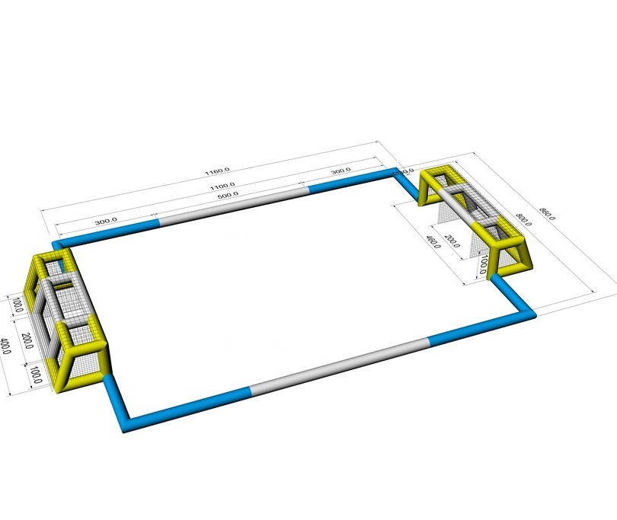
2 versions of WSB mobile field
Inflatable WSB mobile field
made of anti-UV PVC tubes

Slide 9
Unique ball
Notes:
Its special surface requires unique ball technique
The ball has been developed in accordance with the rules of WSB

Slide 10
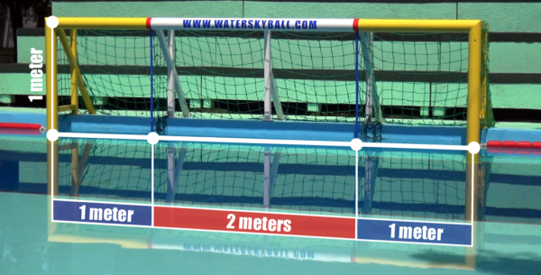
Unique goals
Unique, goal-in-goal solution
4 metres wide, split goal
With 1-2-1 metres sections
Goals can be acquired from different zones
For different points (1, 2, or 4 points)

Slide 11
Unique ball technique
One-handed throw
Gripping the ball is not allowed
The throwing technique requires focus on the whole body
The invested work prevails instead of physical advantages
Notes:
Gripping the ball: means the player exerts a force on the ball with the tip of his fingers
The ball lies on the palm.
Throwing technique develops the whole body
The legs are involved in the throw (as opposed to water polo)
Rotational movement with the hips and upper body.

Slide 12
Non-contact sport
Sport without physical contact instead of body against body fight
The successful game requires agility, speed, tactics, and situation awareness
Touching other players is strictly forbidden and it entails a penalty
The risk of injury is minimal, players can hardly get injured during the games.
Players do not have to fear from sports injuries. This makes WSB a preferred sport for children.

Slide 13
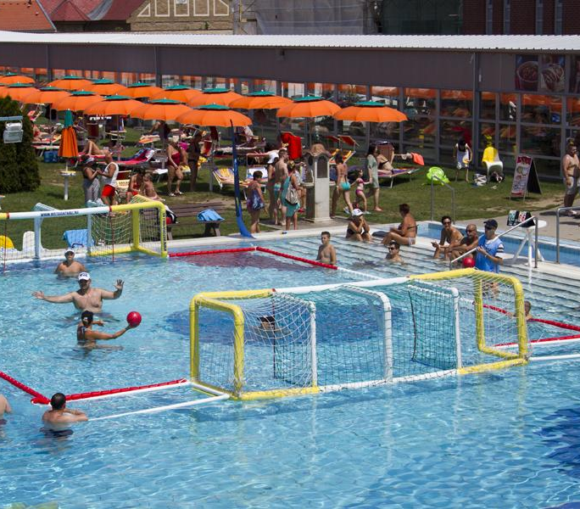
New generation of sports
WSB develops both physical and mental skills
Improves and preserves health
Non-contact rule -> minimal risk of injury
Fun for all ages
Excitement is guaranteed
The ruleset of the game encourages constant playing and endeavor to score
The goals with different values lead to tense and exciting matches

Slide 14
WSB ethos
WSB is based on a unique approach named sport philosophy
The pillars of WSB ethos:
Mutual respect
Non-contact sport
Health preservation and promotion
Self-development
Community building

Slide 15
Our results
Organising 7 national championships
Establishing the Hungarian Water Skyball Association and 10 water skyball sport clubs
Developing, manufacturing and installing WSB mobile fields
WSB in education: from January 2020, WSB is a subject at Physical Education and Sports Center of Budapest Business School
Winning Erasmus+ grant and Hungarian national grants
Several WSB sport events at different swimming pools and beaches in Hungary
Amateur mixed cups for female and male players and kid and adult players
Numerous television and online appearances: M4 Sport, Sport TV, MindigTV, Spieler 1, Spieler 2
Notes:
Jacky: WSB alap irányok mentén felbontani az “Our results” Timeline a honlapról + egy slide a célokról!

Slide 16
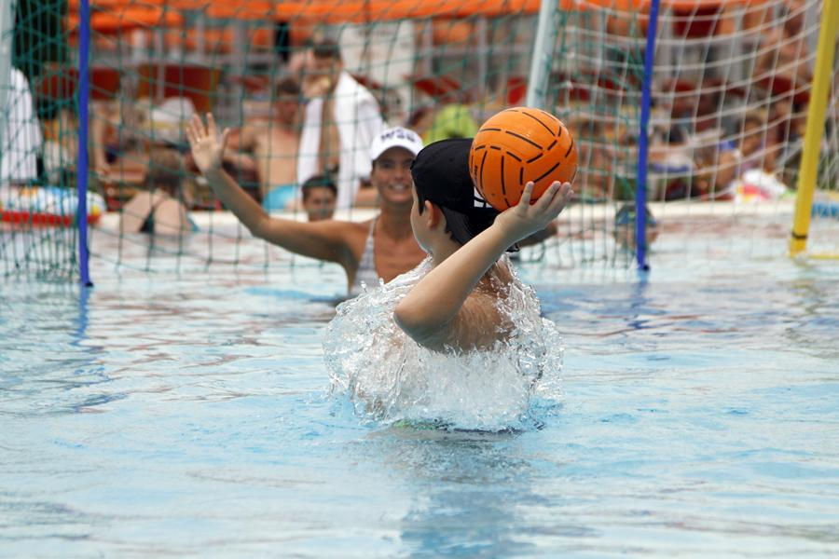
Plans
International debut: Erasmus+ Sport programme, Water Skyball in Europe Part 2
Increasing appearance in television and online
Installation of WSB fields in 10 Hungarian swimming pools
WSB Junior School
Organizing WSB Junior Tournaments
Training coaches

Slide 17
Questions and answers

