Slide 1
Introduction to Water Skyball Sport
Part 2

Slide 2
Goal
The goal of this session is to introduce you to the water skyball sport and to present its ethos and health-promoting properties.

Slide 3
What is the ethos?
WSB is based on a unique approach named sport philosophy
Ethos: the set of beliefs, attitudes, habits, etc., that are characteristic of a sport.
WSB ethos is also in alignment with European Values:
promoting social inclusion,
tolerance,
multi-generational opportunity,
gender equality,
sport access to all.
Pillars of WSB ethos: non-contact, mutual respect, health preservation and promotion, self-development, community building

Slide 4
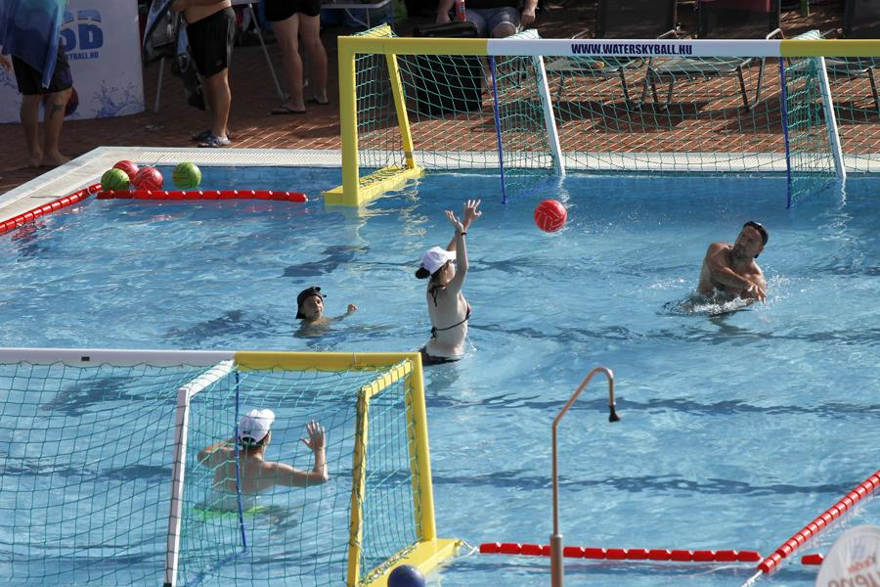
Non-contact sport
A sport without physical contact
NO body against body fight
NO touch on other players
Location and movement of other players have to be considered
Player’s area rule
Other skills need to be developed than physical strength, e.g. tactics, speed, agility, situational awareness
The risk of injury is minimal -> attractive to many people

Slide 5
Mutual respect
Without the other players there is no game to play and there is no opportunity to do team sports
Mutual respect in the rules:
Non-contact rule
Player’s area: the other player must not reach or enter into this area
No dangerous movement and dangerous play
No arguing with the referee
No rude, abusive, harsh expressions and gestures
At the beginning of the game, greeting the opponents and the referees

Slide 6
Self-development
Striving for self-development while playing
Providing opportunities for all players to develop themselves through challenge and competition
Developing both physical skills (physical condition and coordination) and mental skills (attention, tactic, teamwork, situational awareness, etc.)

Slide 7
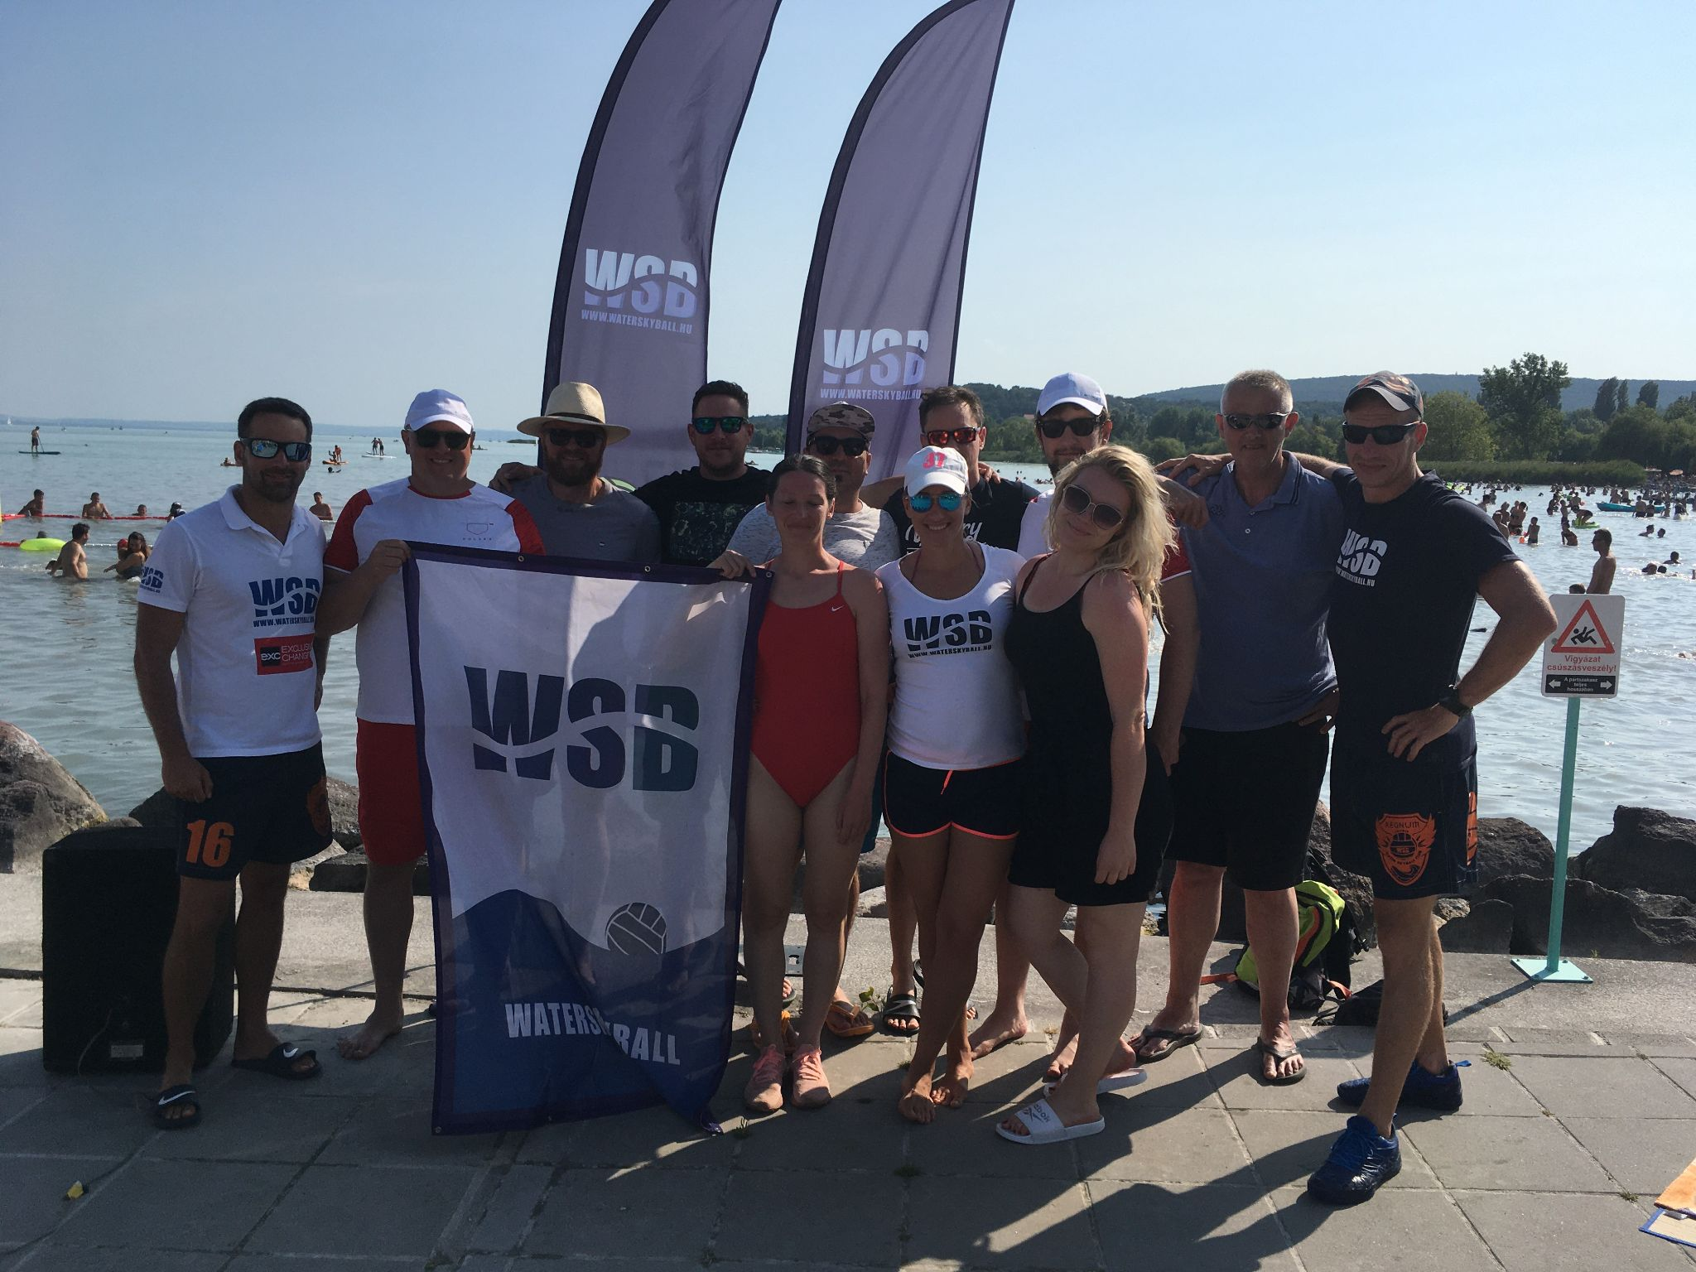
Community building
Community is a strong motivating factor for people to do sports
WSB is fun to play
People get positive experiences by playing WSB
Community is a consequence of non-contact, fun, and mutual respect aspects
Players are often referees as well
Players and fans are volunteers at sport events
Building community around values

Slide 8
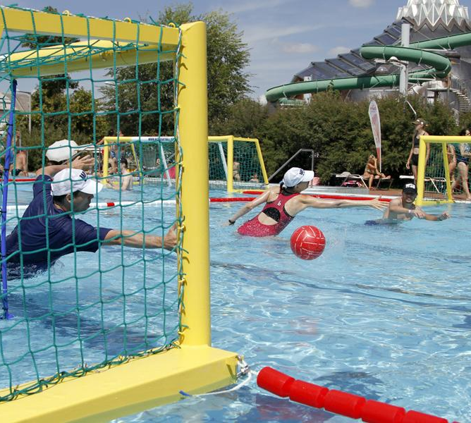
Health promotion effects of WSB
WSB was developed by scientific people (doctors, coaches, physical education specialists and experts of sport philosophy)
The result of Fontanus Center
Became an independent sport later

Slide 9
Conditional skills
Development of movement speed
changing zones
interception
scoring goals
goalkeeping
Development of endurance
moving against significant resistance
Development of force
shooting on goal
Cardiovascular system:
The development of the circulatory system is the basis for the development of conditioning skills
the bottom torso works in water (unusual medium)
the upper torso works in air (usual medium)
Notes:
Since the bottom torso is surrounded with water, circulation needs to adjust the pressure difference between the bottom and the upper half of the body
During movement, the upper torso works in its usual medium (warm air on a sunny summer day), and legs, while the bottom torso works in a colder and denser medium, against significant resistance

Slide 10
Coordination skills
Sense of rhythm - coming from the zone changing, passing, blocking, interception
Spatial awareness (spatial-kinaesthetic awareness and spatial-kinaesthetic-object awareness) - coming from the special set-up of the field and the players’ movements
Reaction ability - coming from the game speed, passing, players’ movements on the field
Kinaesthetic ability - coming from the ball handling requirements and throw technique
Balance ability - coming from the movement in the water
Notes:
Sense of rhythm - resulting in greater alignment with the game
Spatial awareness - resulting in a better sensation of the physical environment
Reaction ability - resulting in faster reaction time
Kinaesthetic ability - resulting in better ball handling, throwing
Balance ability - resulting in more efficient movement

Slide 11
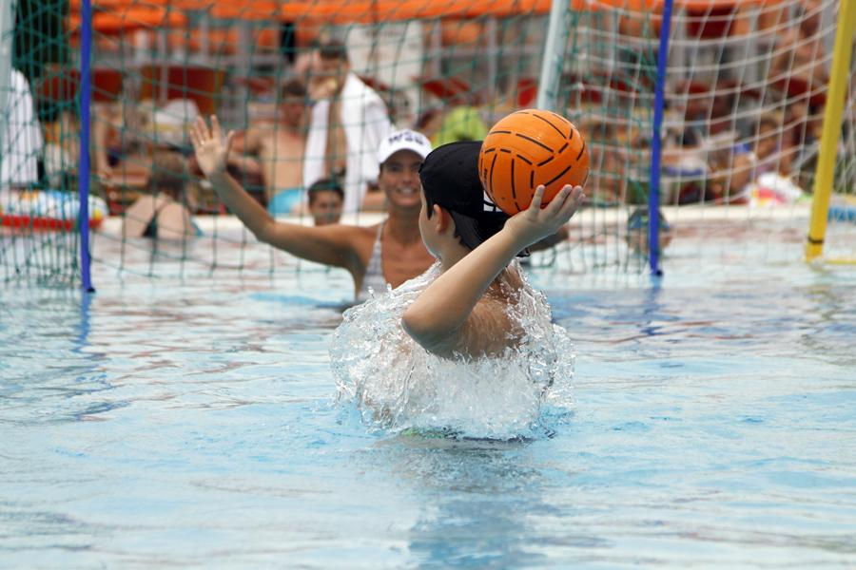
Cognitive skills
Sense of strategy
Situational awareness
Teamwork and cooperation
Body consciousness
Movement control
Notes:
WSB is mainly an intellectual sport
Teams with a better tactical and strategic can outplay their opponents
Situational awareness: keeping all three other players in perspective
Teamwork: Any successful team needs to master teamwork and close cooperation, e.g. interception, defence
Players need to consider their arms, legs and other body parts to predict the result of a movement, as any contacts are strictly sanctioned by the referees.

Slide 12
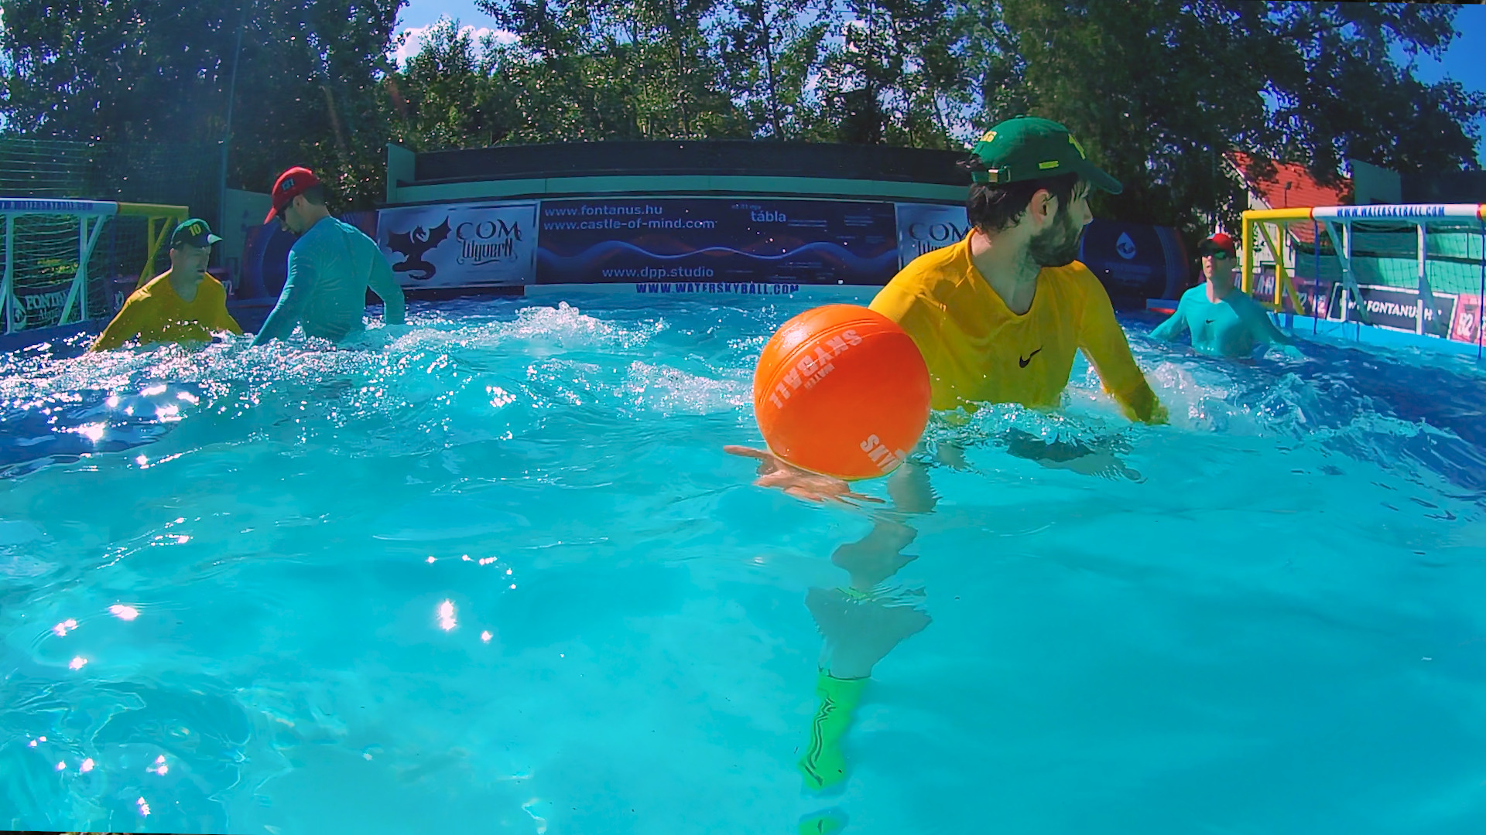
Who might be interested in this sport?
People interested in
non-contact sports
easy to learn sports
recreational sports
ball games
Parents who are afraid of sport injuries to their children
Sport clubs: swimming clubs, water polo clubs, leisure sport clubs
Sponsors: energy drink, sports drink, sportswear, sports equipment, food supplement manufacturers
Media: sport TV channels

Slide 13
Questions and answers

